Slide 1
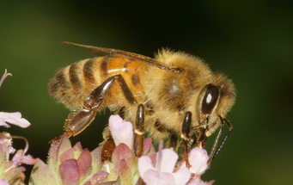

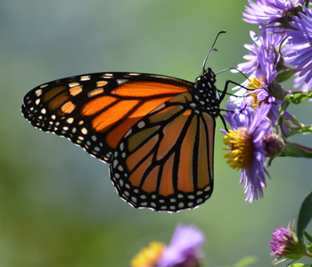
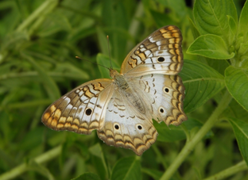
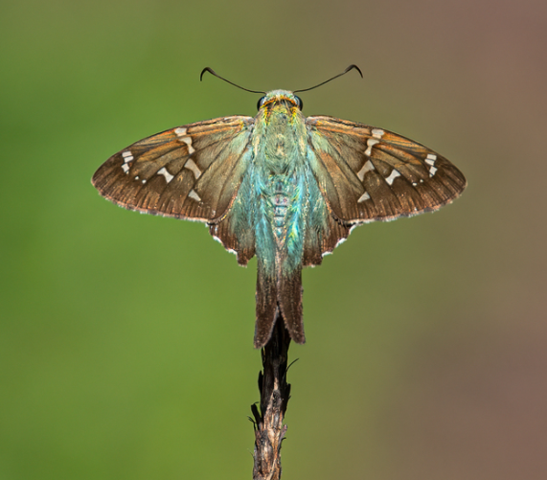


Changes in Insect Pollinator Phenology
Across a Gradient of Anthropogenic Change in Florida
Marina K. Marquis, Brittany M. Mason, & Corey T. Callaghan
Department of Wildlife Ecology and Conservation,
University of Florida

Slide 2
Table of Contents
Background
Methods
Preliminary Results
Conclusions

Slide 3
Table of Contents
Background
Methods
Preliminary Results
Conclusions

Slide 4

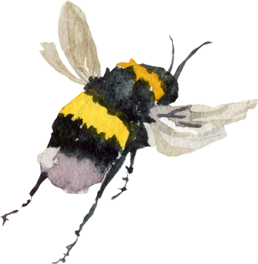
The Role of Insect Pollinators in the Ecosystem

Slide 5


Slide 6
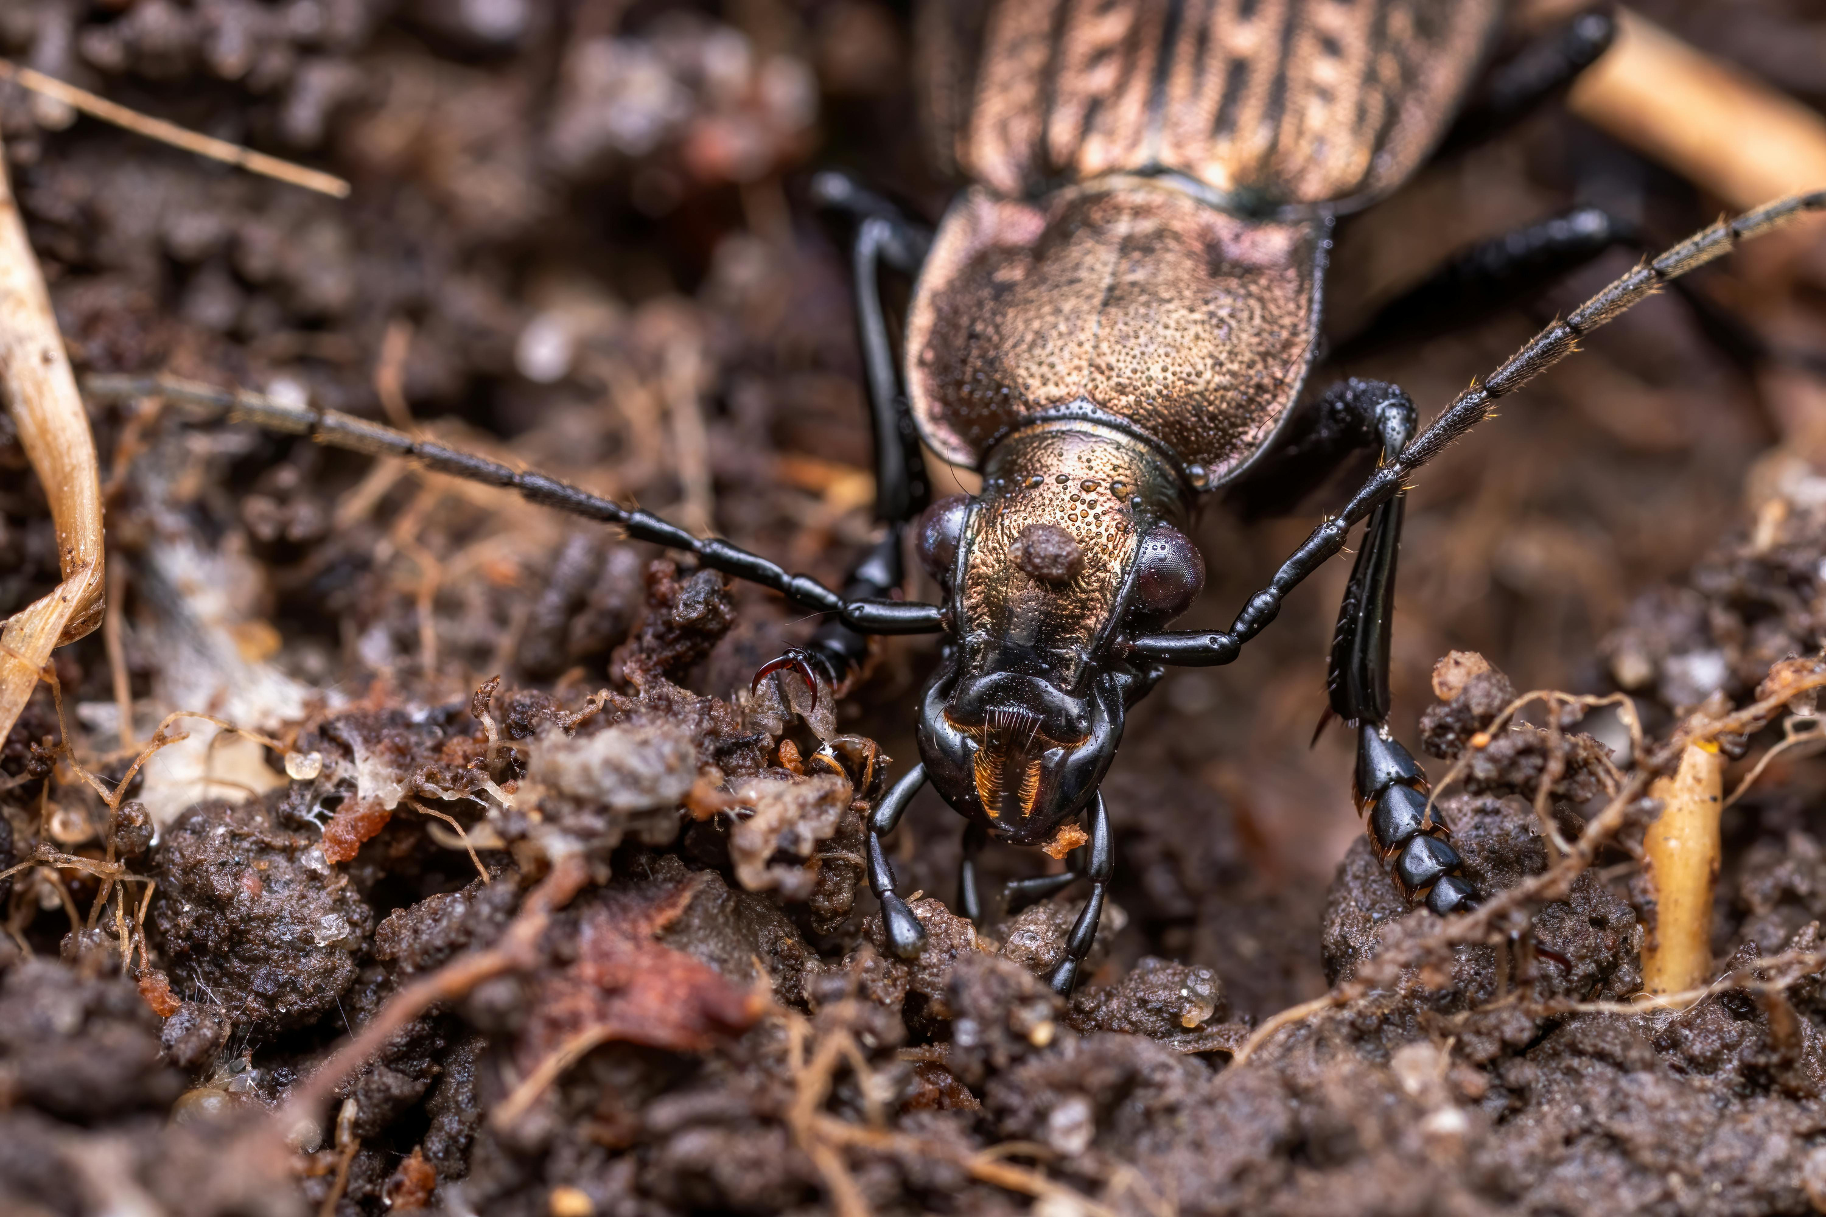
Tilling and Aerating Soil

Slide 7
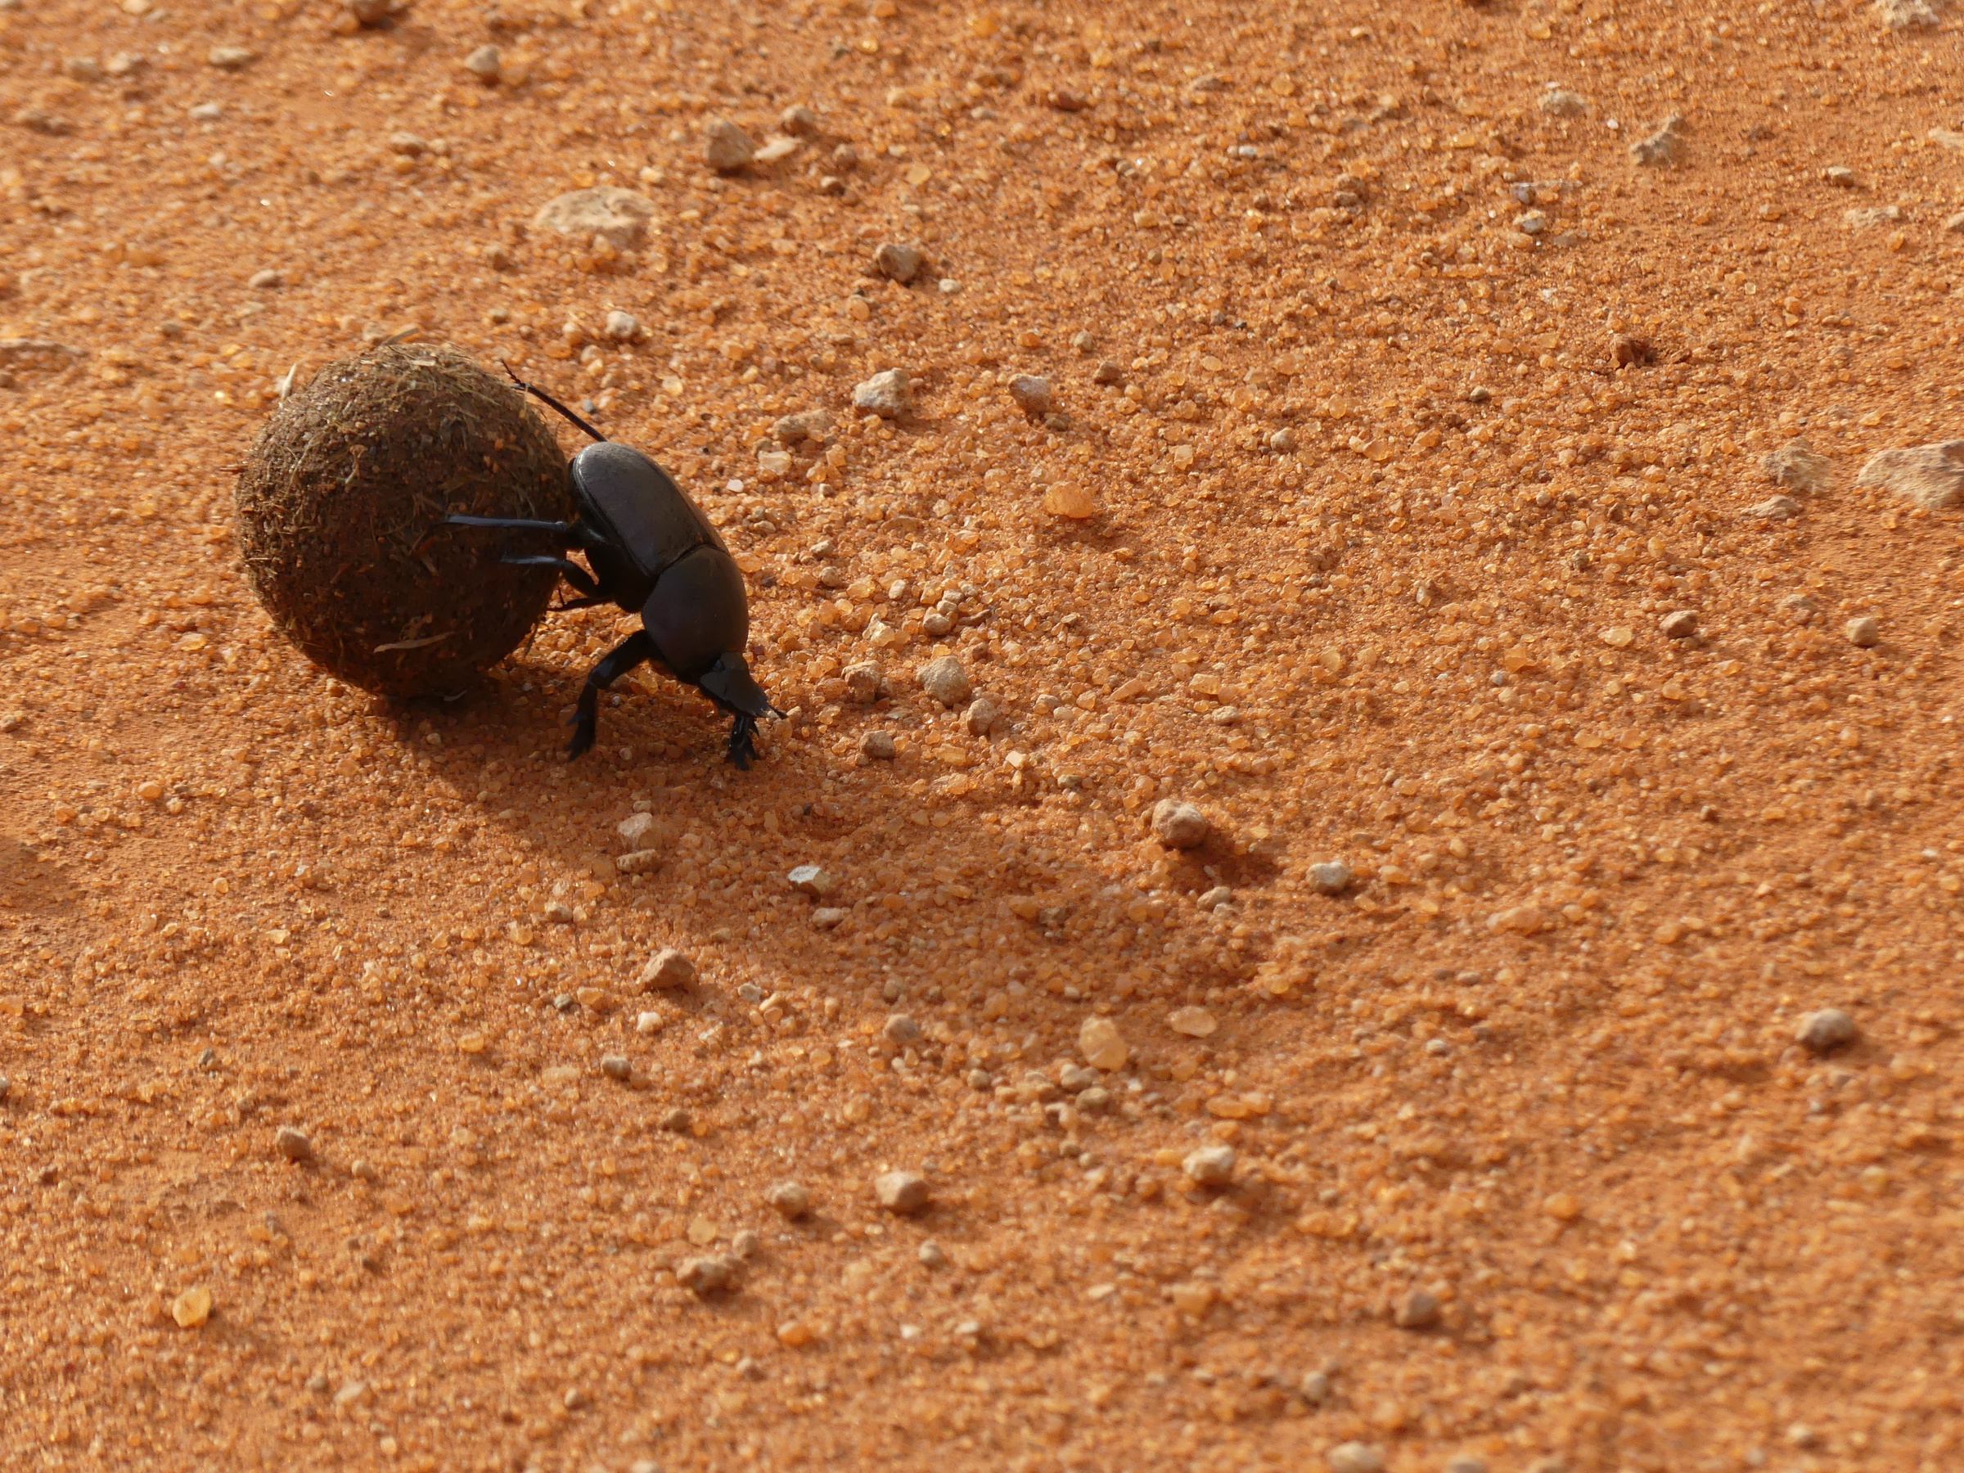
Aiding in Decomposition

Slide 8
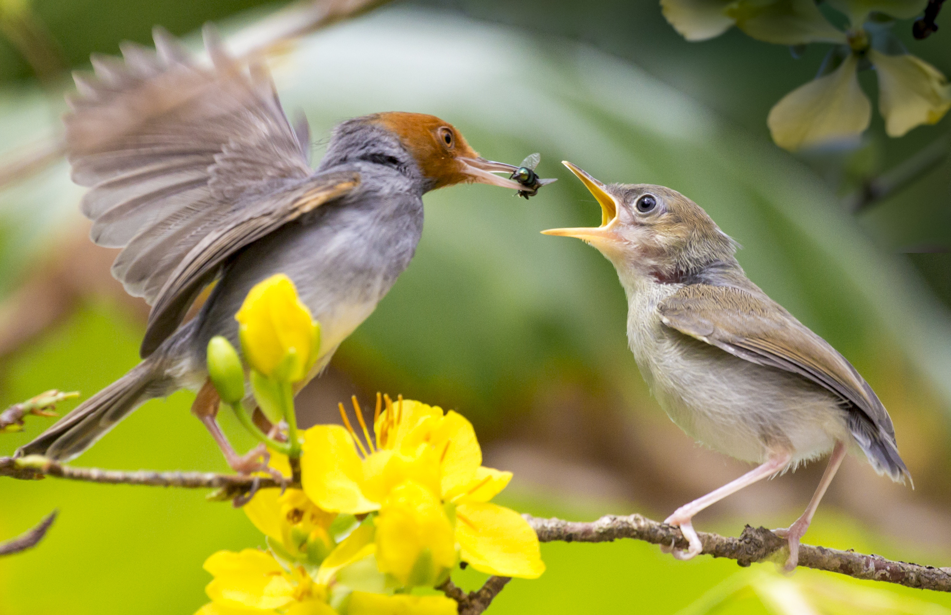
Abundant Food Source

Slide 9
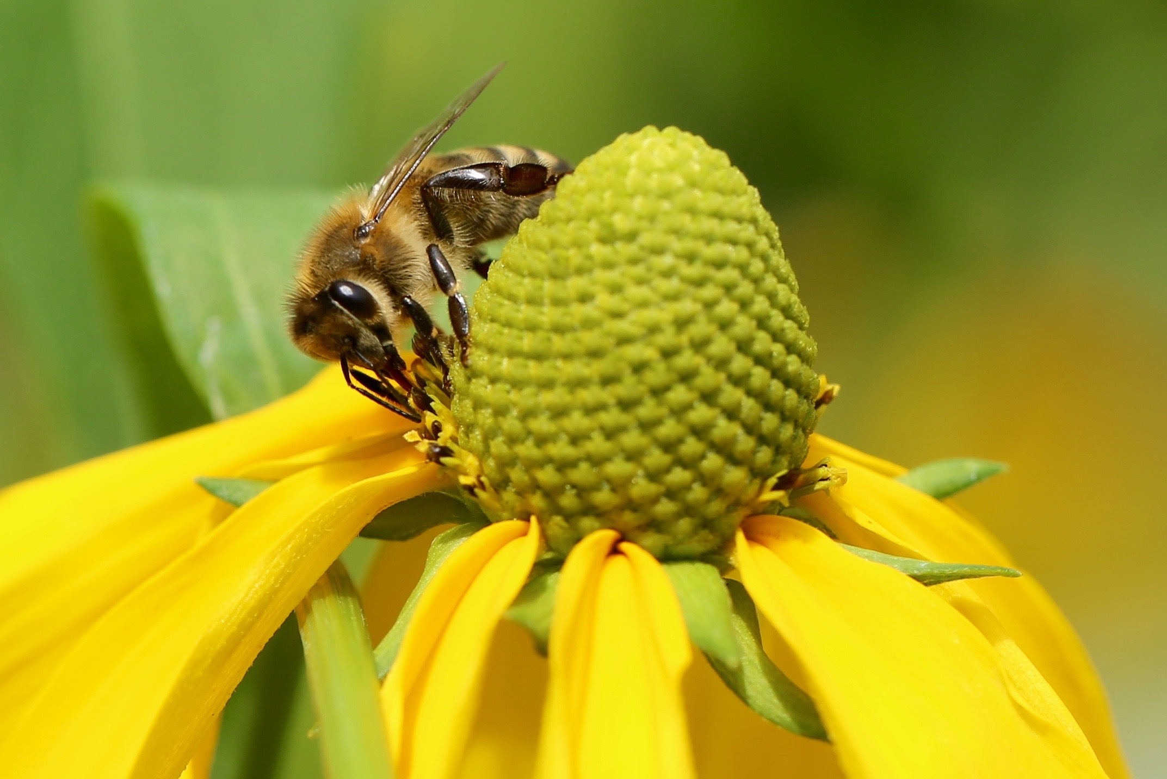
Pollination

Slide 10


“About two thirds of the crop plants that feed the world, plus many plant-derived medicines in our pharmacies, rely on pollination by insects or other animals to produce healthy fruits and seeds. Of the slightly more than 100 crop species that provide 90 percent of national per capita food supplies for 146 countries, 71 species are bee-pollinated (but relatively few by honeybees), and several others are pollinated by thrips, wasps, flies, beetles, moths and other insects.”
FAO. (2004). Conservation and management of pollinators for sustainable agriculture—The international response.

Slide 11
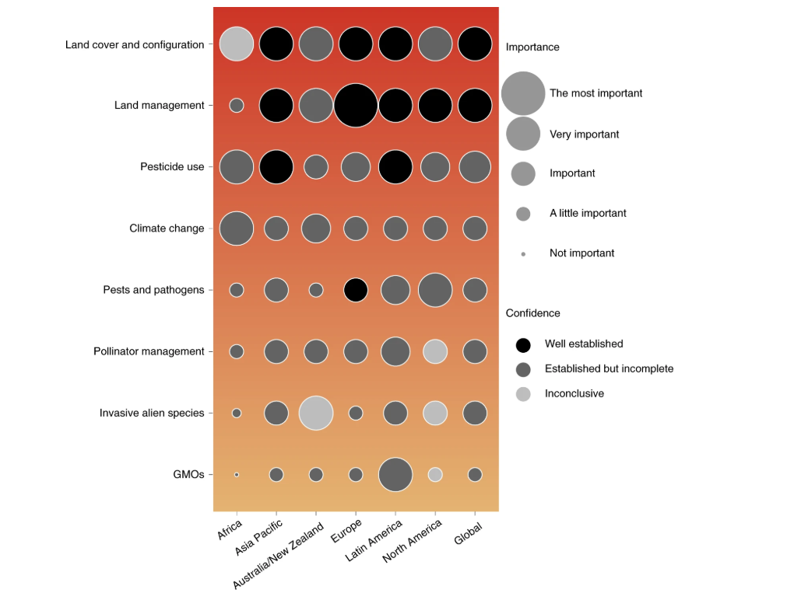
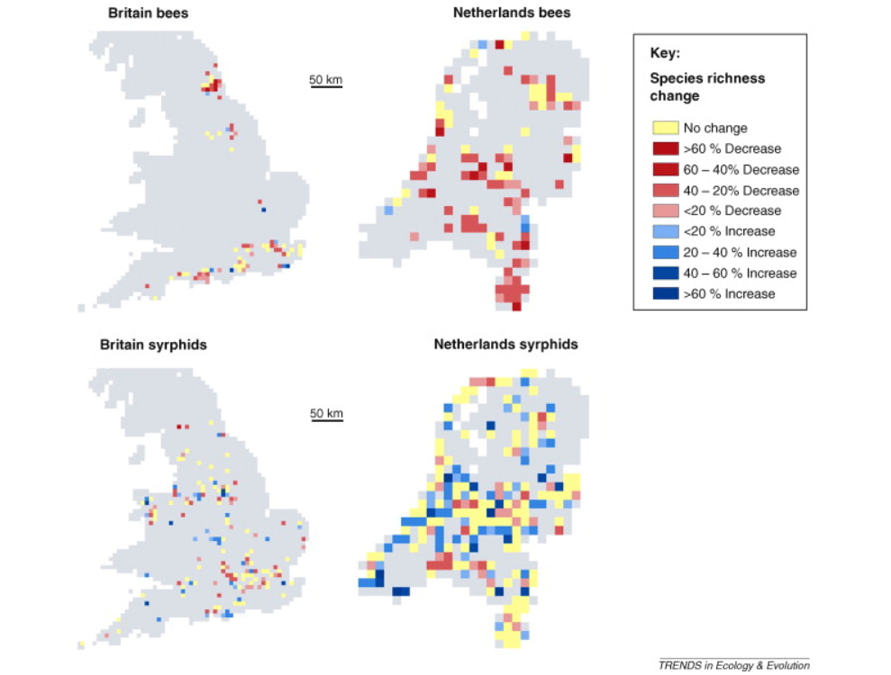
Urban Factors Have Been Linked to Insect Pollinator Declines
Dicks et al., 2021
Potts et al., 2010

Slide 12
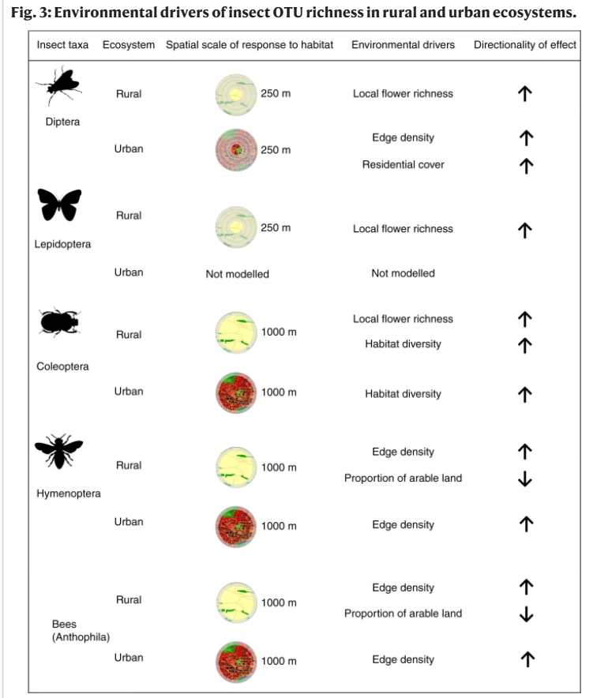



While the richness and abundance of Hymenopterans and generalist pollinators increases in cities, the opposite is true for Dipterans, Lepidopterans, and specialist pollinators (Theodorou et al., 2020)
Urbanization can have negative, positive, neutral, or mixed effects on pollination (Silva et al., 2023)

Slide 13
While the richness and abundance of Hymenopterans and generalist pollinators increases in cities, the opposite is true for Dipterans, Lepidopterans, and specialist pollinators (Theodorou et al., 2020)
Urbanization can have negative, positive, neutral, or mixed effects on pollination (Silva et al., 2023)
Most urban pollinator studies are conducted in temperate cities of Europe and North America (Silva et al., 2021)

Slide 14
While the richness and abundance of Hymenopterans and generalist pollinators increases in cities, the opposite is true for Dipterans, Lepidopterans, and specialist pollinators (Theodorou et al., 2020)
By 2050, more than two-thirds of the world’s population is expected to live in cities (Gerten et al., 2019)
Urbanization can have negative, positive, neutral, or mixed effects on pollination (Silva et al., 2023)
Most urban pollinator studies are conducted in temperate cities of Europe and North America (Silva et al., 2021)

Slide 15
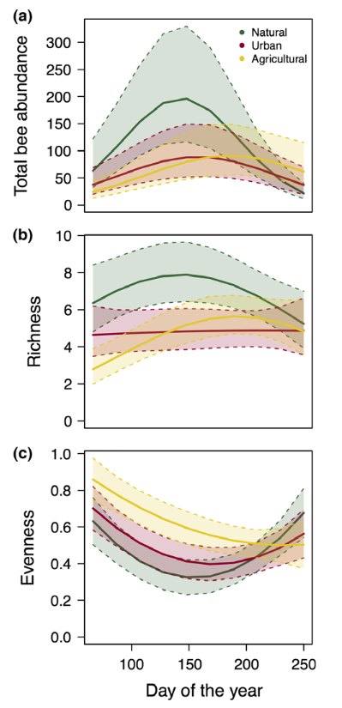
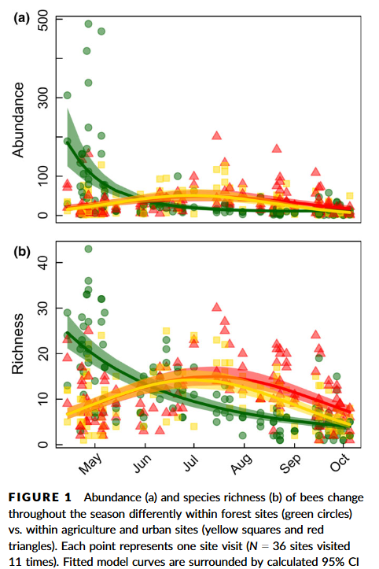
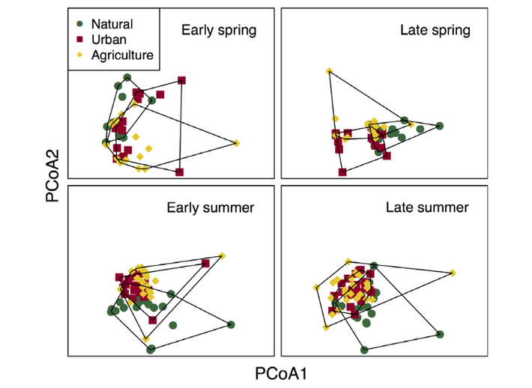
Some studies suggest that urbanization can shift pollinator phenology – in this case, flight period. These studies, however, are mostly focused on bees and small in spatial scale.
Leong et al., 2016
Harrison et al., 2018

Slide 16

Missing from the studies
What We Would Like to Know:
An overview of the phenology of many insect pollinator species in urban and non-urban areas-- not just bees-- using a large data set
Will these same patterns emerge over a larger geographic scale and with a larger dataset?
Will there be variation by taxonomic and functional groups?

Slide 17

Research Objective:
To assess pollinator phenology as a function of anthropogenic change across taxonomic scales.
Hypotheses:
A) Anthropogenic change will be a significant predictor of pollinator phenology.
B) The pollinator phenological response to urbanization will vary by taxanomic and functional group.

Slide 18
Table of Contents
Background
Methods
Preliminary Results
Conclusions

Slide 19
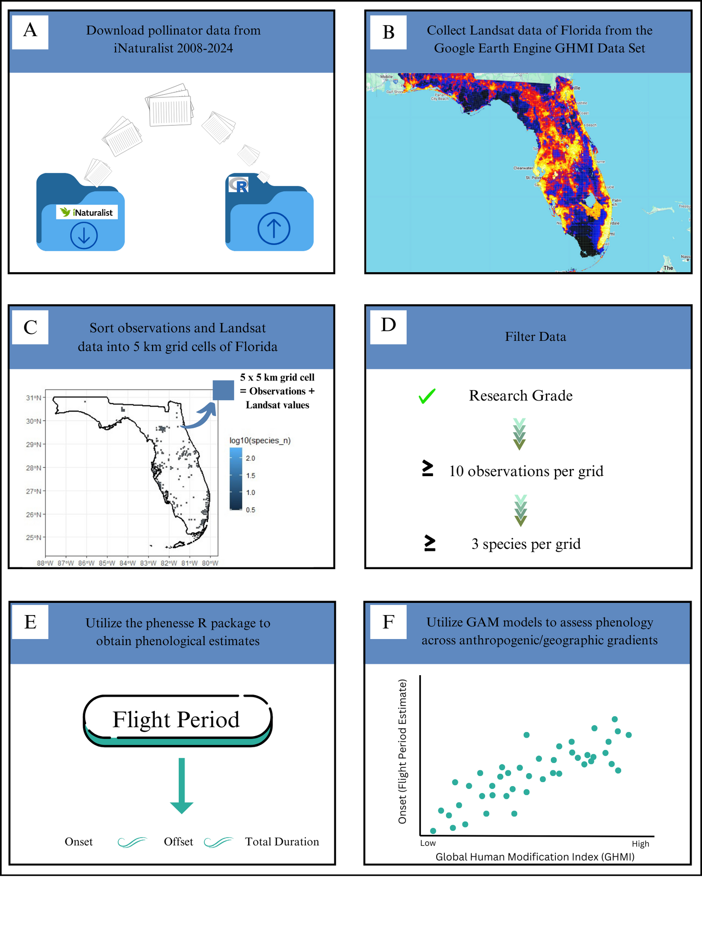

Methodology
Work
Flow

Slide 20


Slide 21
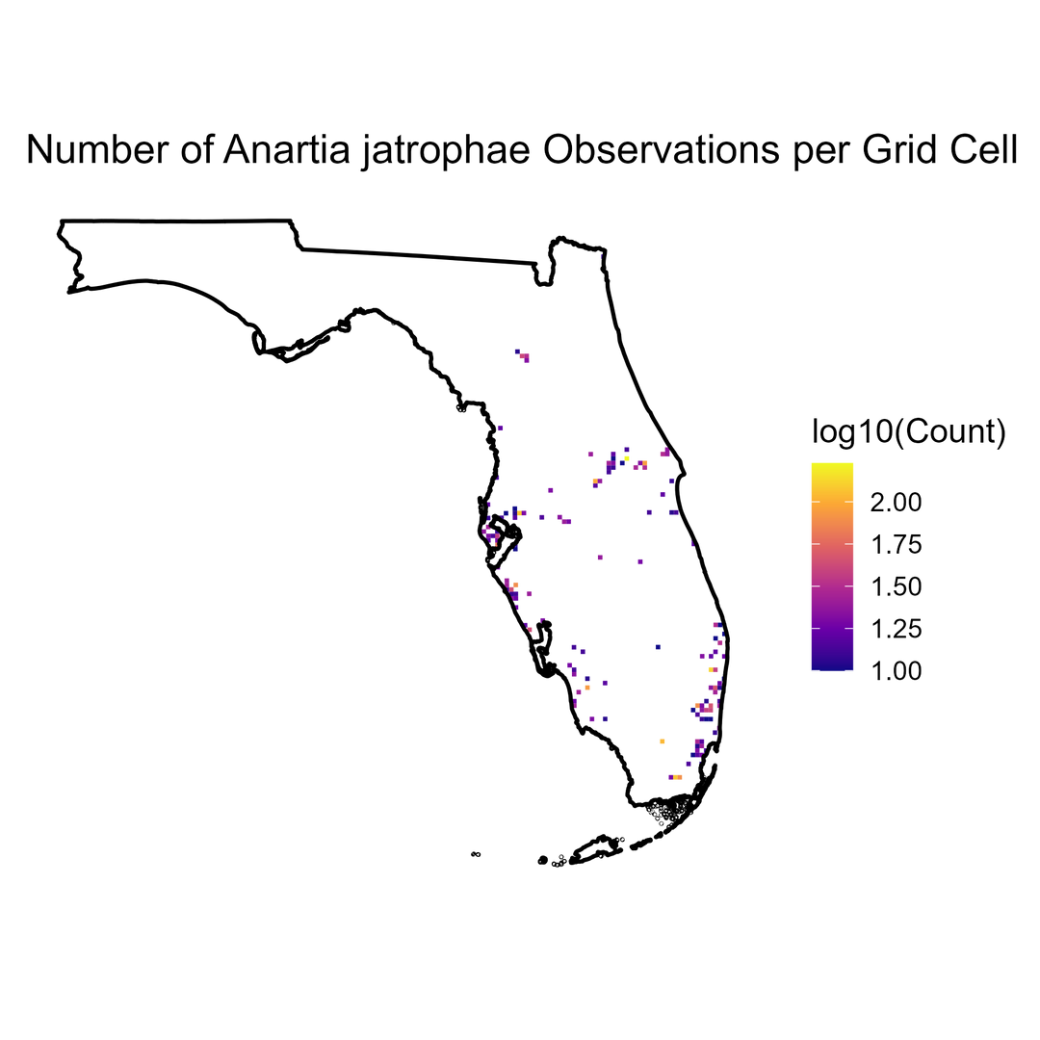
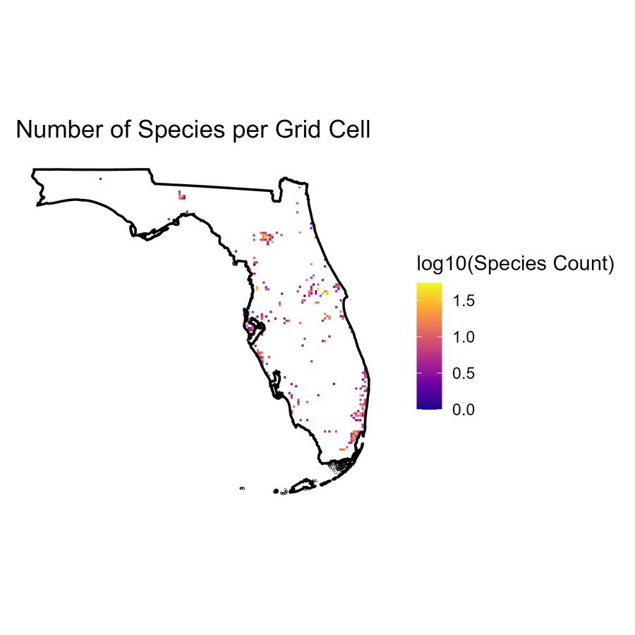
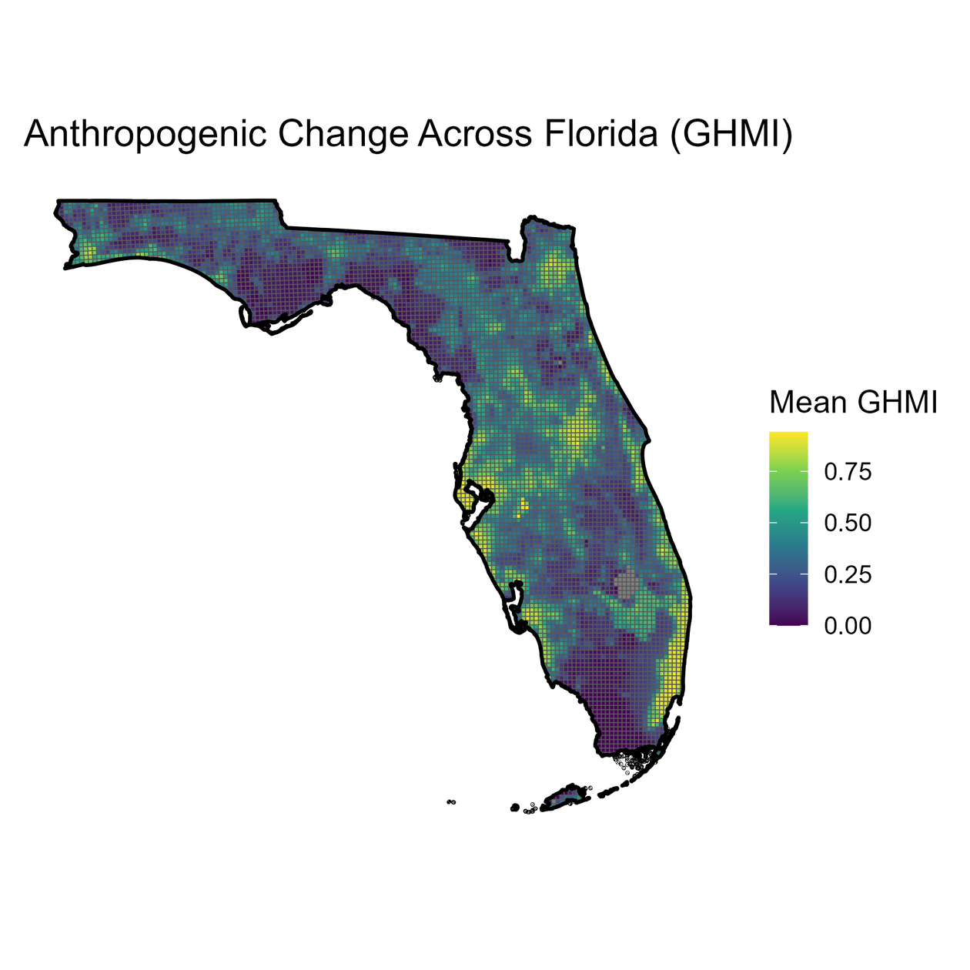
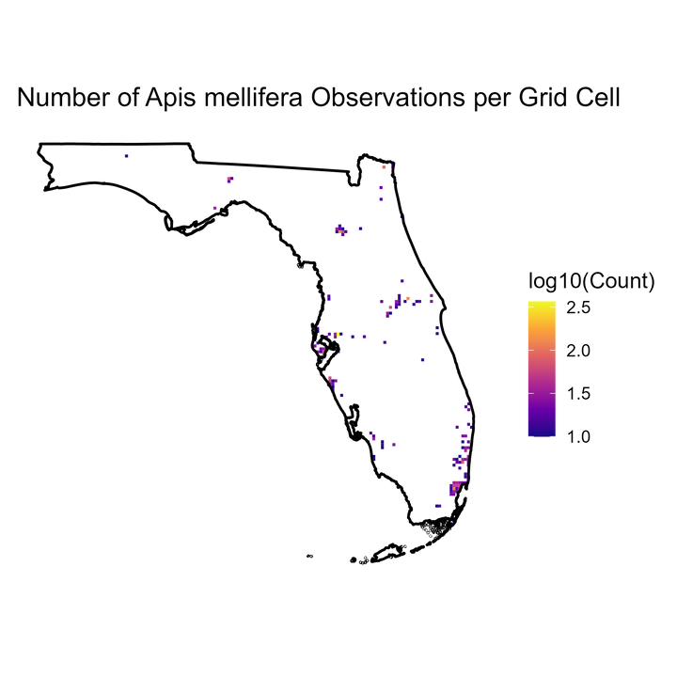
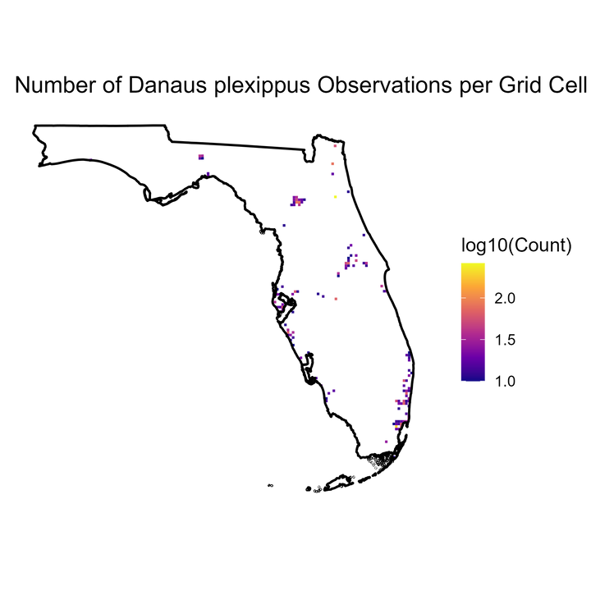
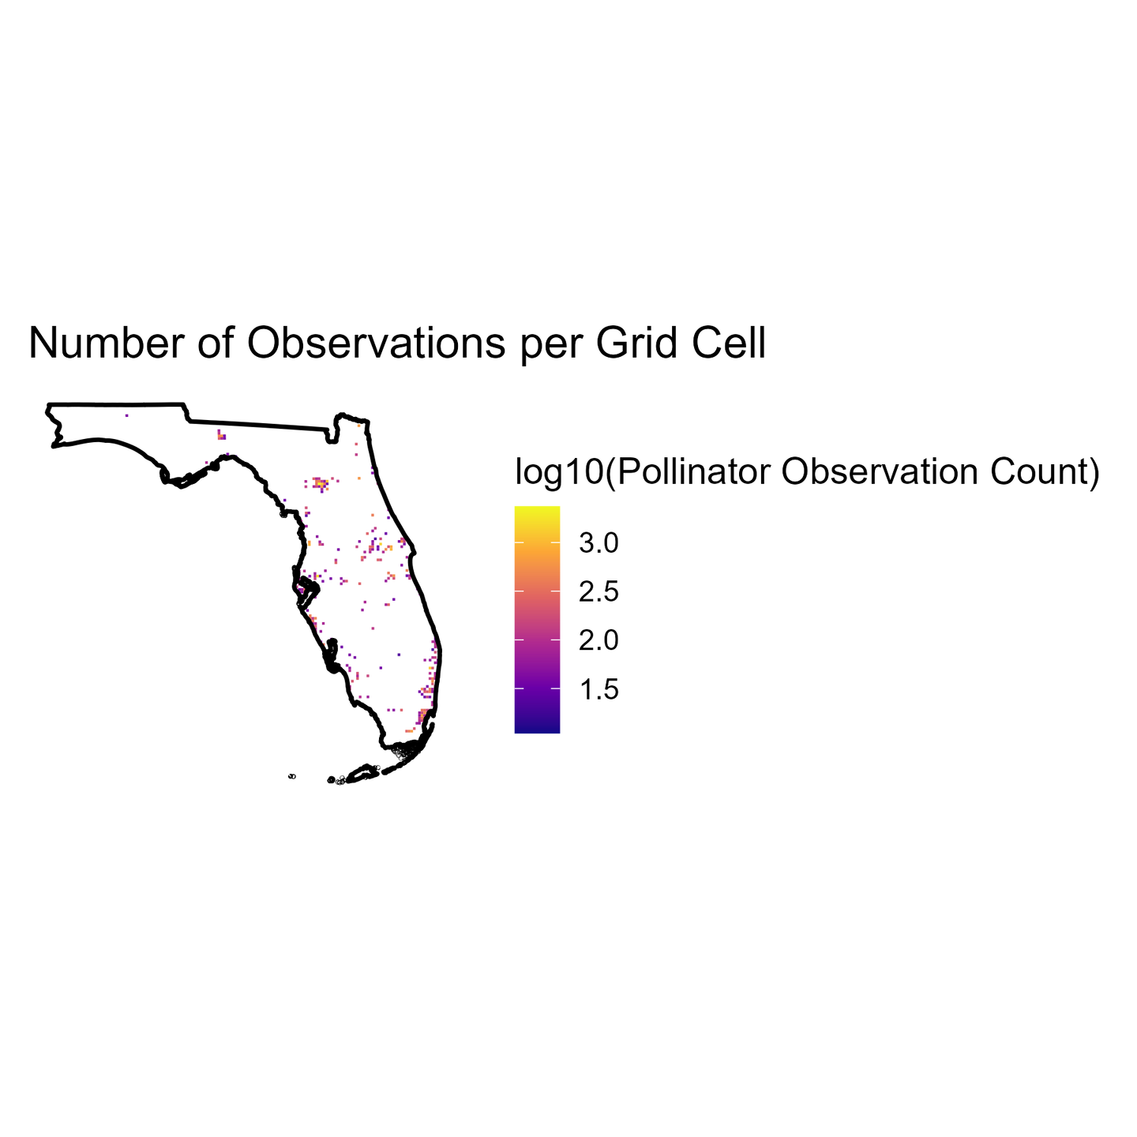
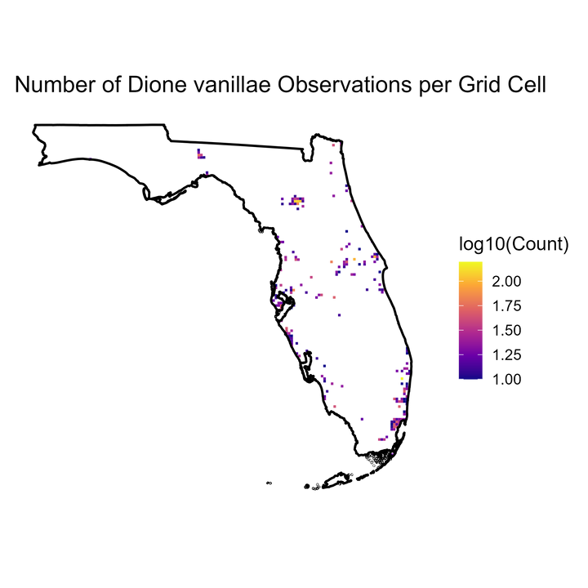
A
D
C
B

Slide 22
Table of Contents
Background
Methods
Preliminary Results
Conclusions

Slide 23
Data Composition:
Orders: Hymenoptera, Lepidoptera, and Coleoptera
68,370 observations
44 families
After Filtering:
417 pollinator species
313 grids met the filtering criteria
6,550 five-kilometer grid cells spanning Florida
Average of 10 species per grid cell
Dione vanillae most abundant species

Slide 24
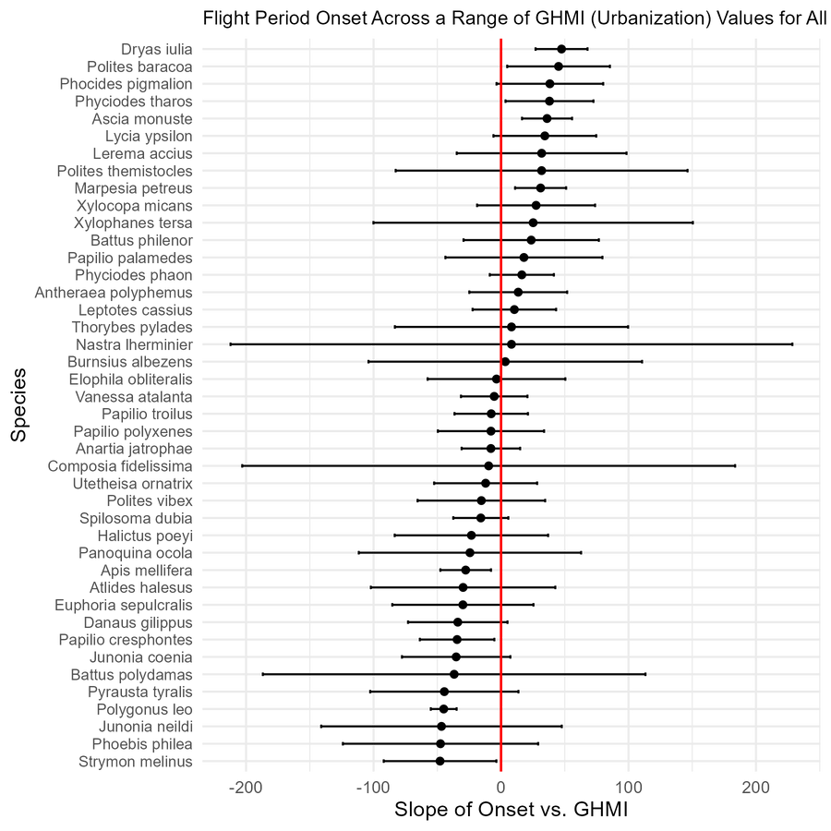
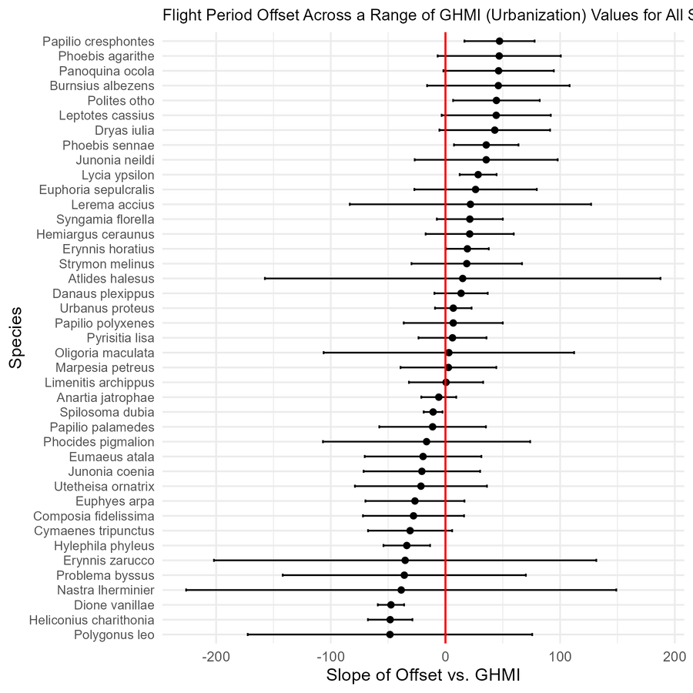
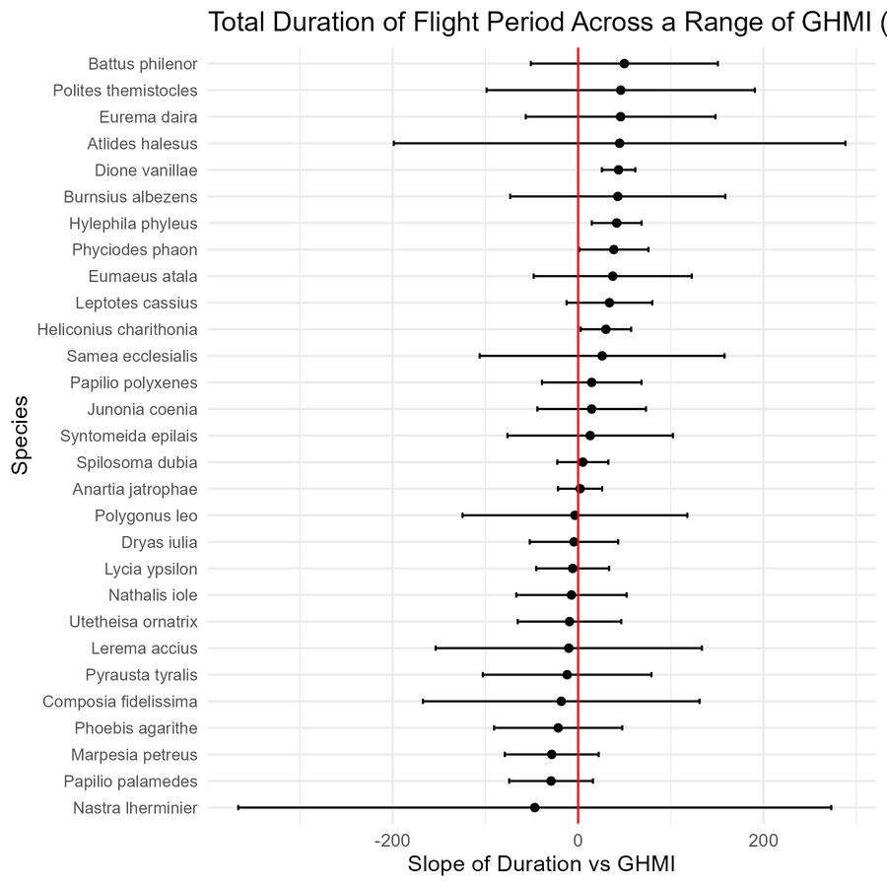
Flight Period Estimates Across a Range of GHMI Values
Onset
Offset
Total Duration

Slide 25
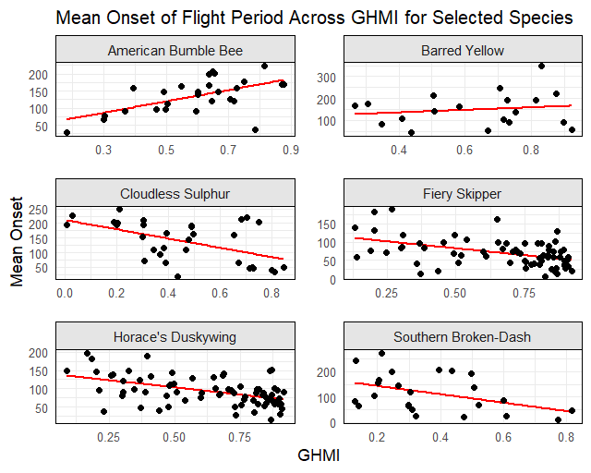
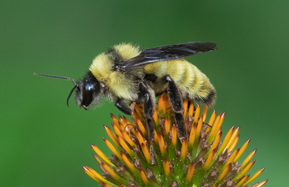
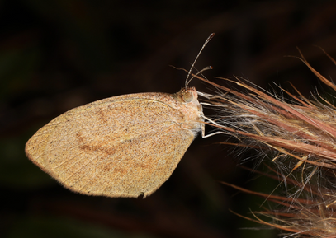
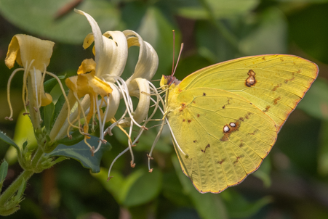
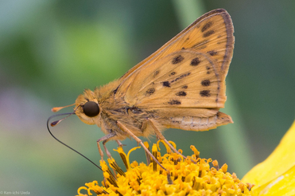
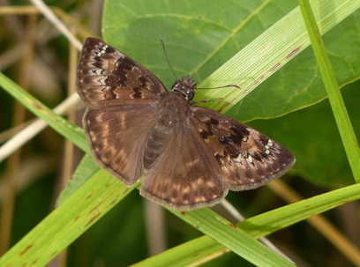
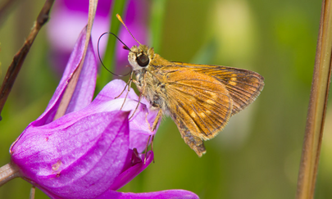

Slide 26
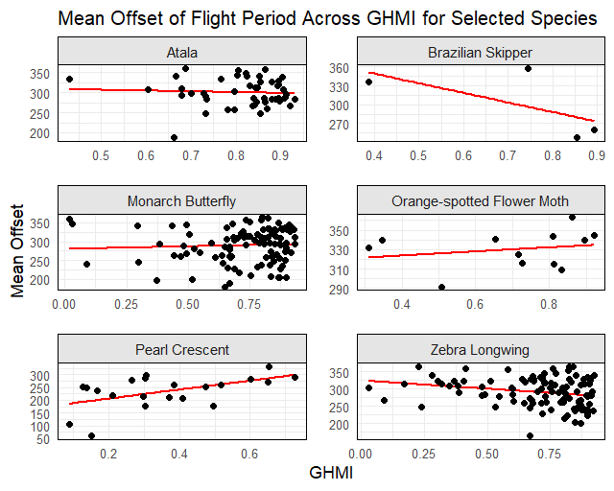
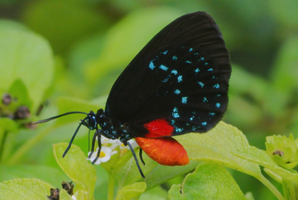
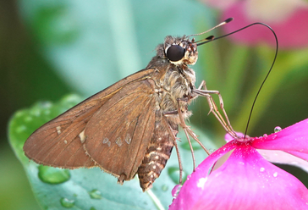
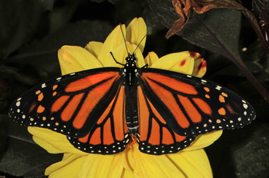
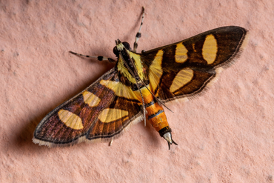
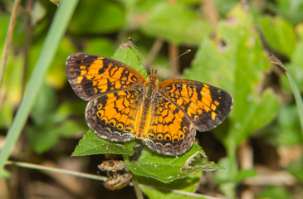
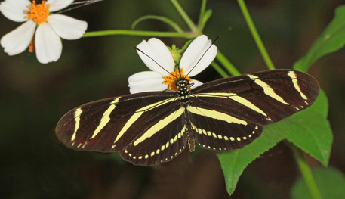

Slide 27
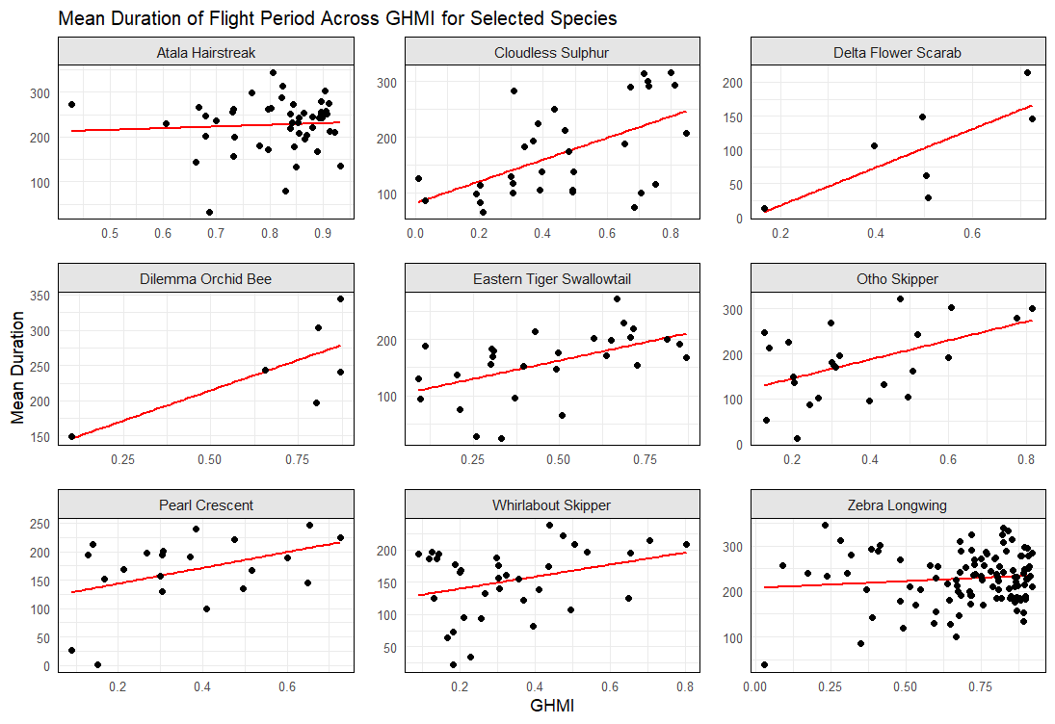
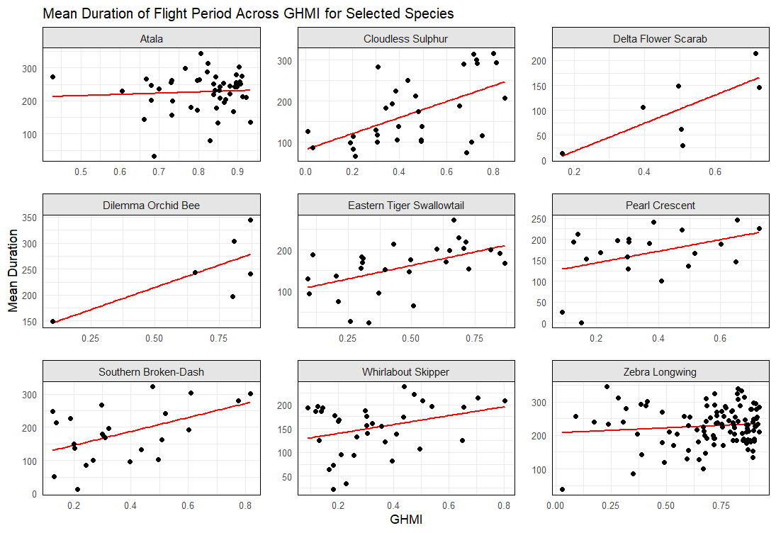
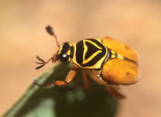
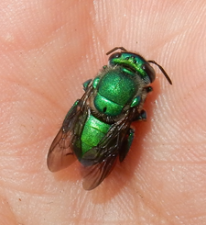
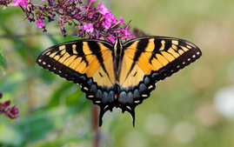
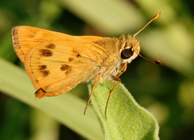
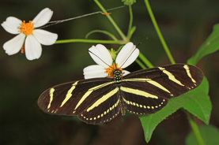

Slide 28
Table of Contents
Background
Methods
Preliminary Results
Conclusions

Slide 29

Preliminary Conclusions, Next Steps
The flight period of some insect pollinator species is significantly predicted by the level of anthropogenic modification
Phenological response to anthropogenic modification varies by species
Future investigations: how this varies by functional group (specialist versus generalist) and morphological traits (e.g., body size)

Slide 30
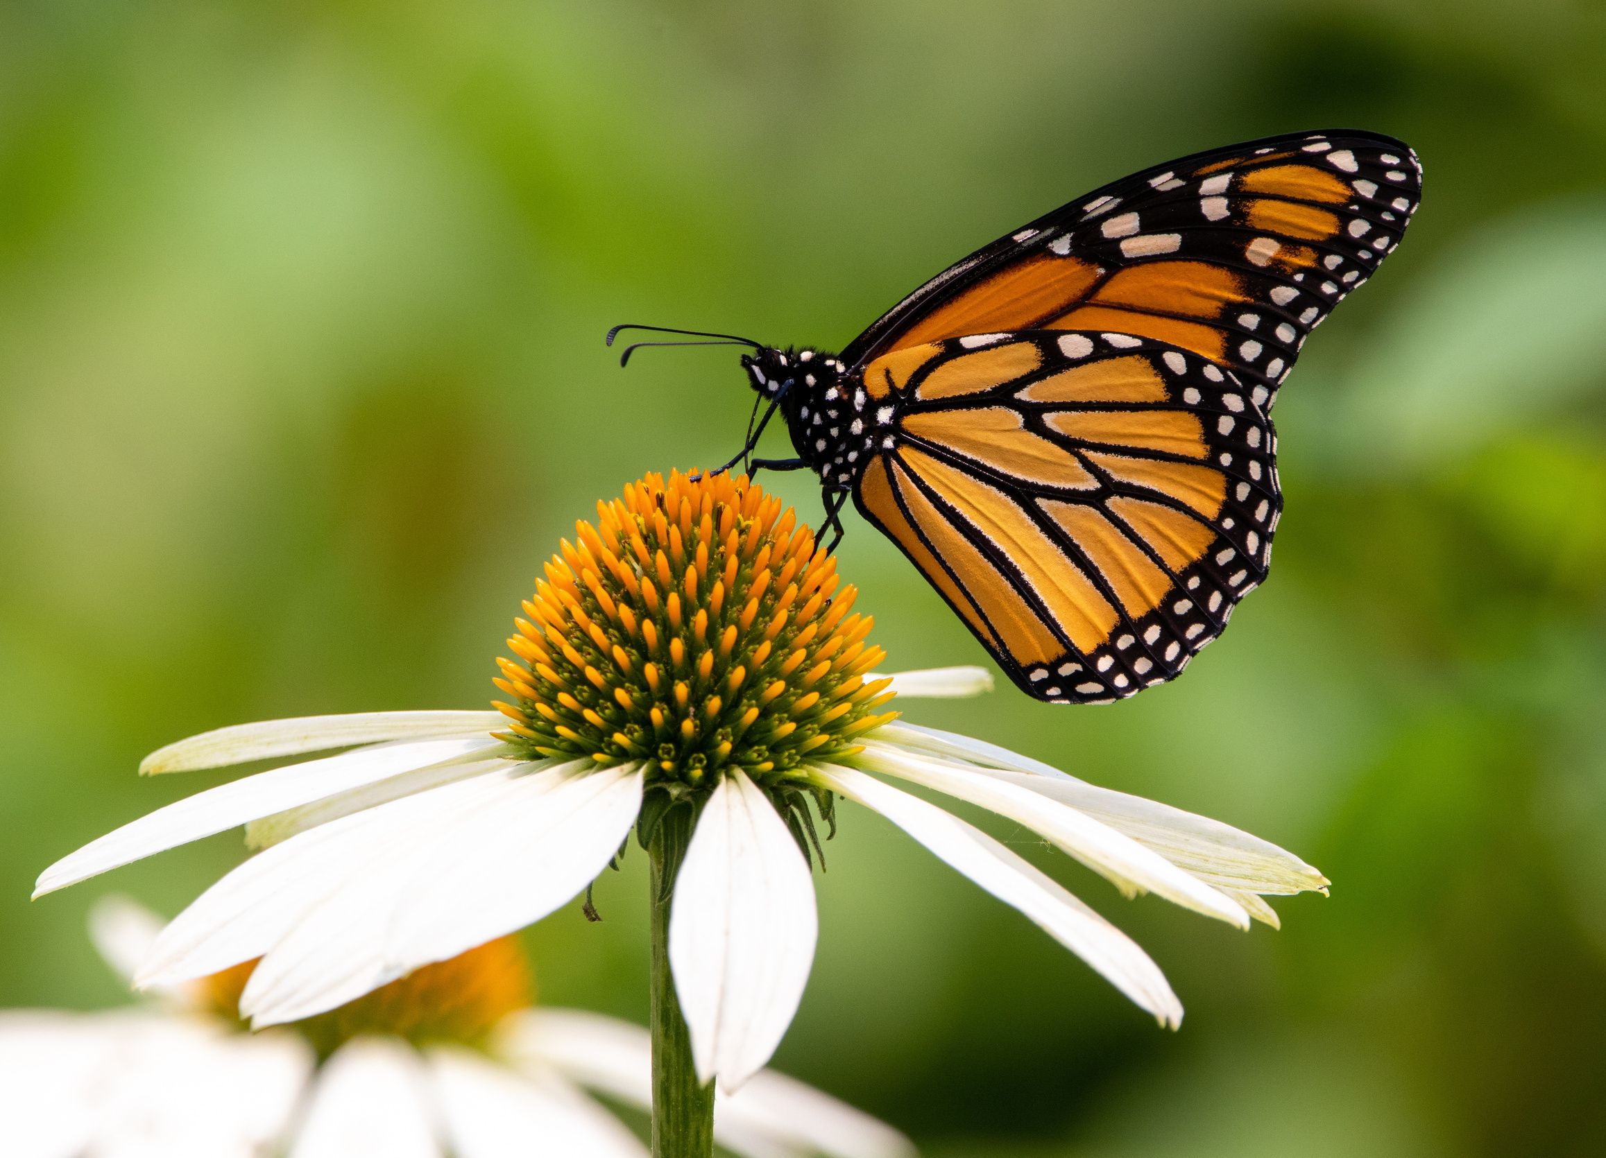
Questions?
Email me at: marina.marquis@ufl.edu

